Slide 1
Space Base
Kaitlyn Landrove

Slide 2
Portfolio
https://github.com/KaitLand12/Portfolio/

Slide 3
Concept
The player is an astronaut on a base on an unknown planet
They are given tasks via computers located throughout the base
The tasks are mini games related to the space theme

Slide 4
Aspects of the Game
Perspective
Lighting
2D Mini Games
Third person camera follows avatar from behind
Dim lighting to mimic darker planet
Simple mini games to provide small challenge to players
Music
Movement
Assets
Music playing while in the base and playing mini games
Normal gravity with movement controlled by arrow keys
Non-realistic assets used for fantasy image

Slide 5
Main Game Scene
Goal: visit all 4 mini games
Colliders on computer console leading to mini games
4 rooms in base
1 computer in each room
Spawn in the middle of the base each time main scene is reloaded
Cannot leave base (colliders)

Slide 6
Mini Games
01
Planet Memory
02
Pipe Connector
A classic memory card game with planet images
Rotate the pipes to connect both ends
03
04
Alien Translation
Rocket Builder
Decode the incoming alien message using the key
Put the rocket pieces together to get back home
01
02
03
04

Slide 7
01
Planet Memory
01
Mouse click input

Slide 8
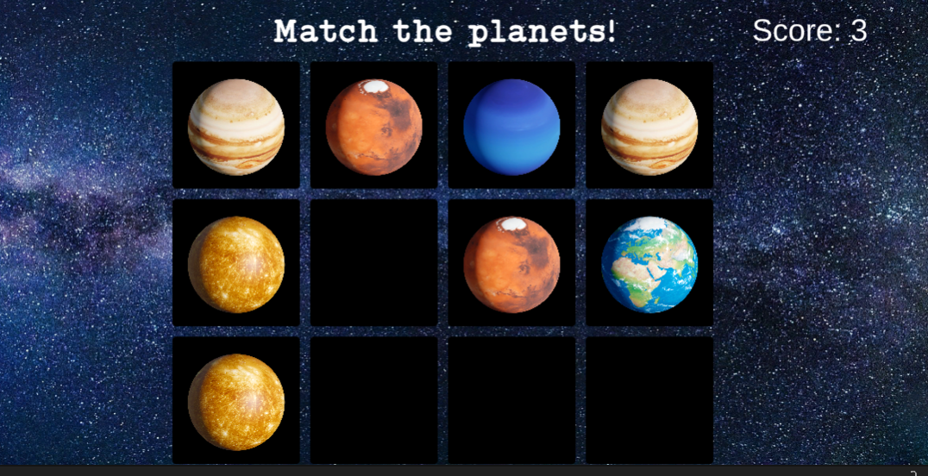
Mouse click to flip cards

Slide 9
01
Pipe Connector
02
UI Button input

Slide 10
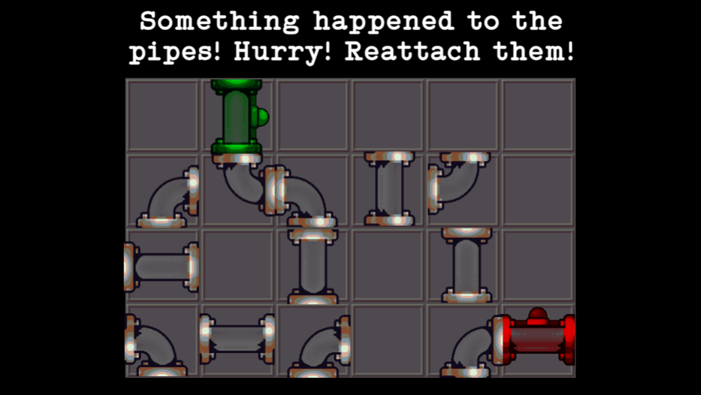
Pipes rotate when clicked

Slide 11
01
Alien Translation
03
Text input

Slide 12
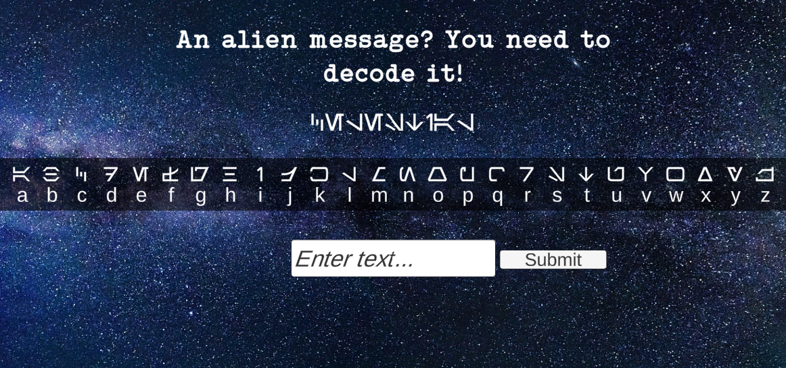
Keyboard input in form of string

Slide 13
01
Rocket Builder
04
Drag and drop mouse input

Slide 14
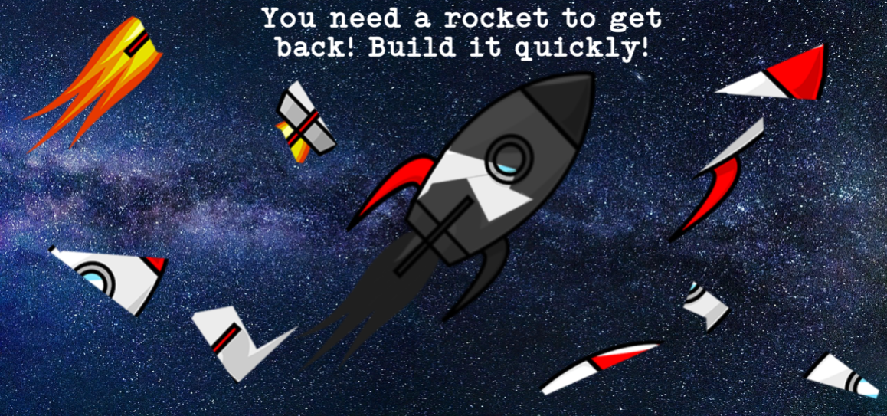
Drag and drop input

Slide 15
Scripts
startscript
camerafollowastro
astromove
MiniGameControl
Loads main scene when start button is clicked
Makes camera follow astronaut from behind
Moves astronaut
Scene manager that switches to each mini game
memorygame
PipeScript
PipeGameManager
Flashing
Controls the memory mini game
Controls pipe rotation when clicked
Detects when all pipes are correct and ends game
Makes the start and end pipes flash green and red
Decode
rocketbuild
BuildGameManager
Moves astronaut
Drag and drop controls to build rocket
Detects when rocket pieces are in the correct place and ends game

Slide 16
Assets
Base | https://assetstore.unity.com/packages/3d/environments/sci-fi/sci-fi-styled-modular-pack-82913
Astronaut | https://assetstore.unity.com/packages/3d/characters/humanoids/sci-fi/free-animated-space-man-61548
Planets in Memory Game | https://assetstore.unity.com/packages/2d/gui/icons/planet-icons-176807
Galaxy Background | https://pixabay.com/photos/milky-way-stars-night-sky-2695569/
Pipes | https://opengameart.org/content/puzze-pipe-set
Music | https://pixabay.com/music/ambient-cosmic-glow-6703/
Rocket | https://clipartmag.com/download-clipart-image#rocket-clipart-7.png

Slide 17
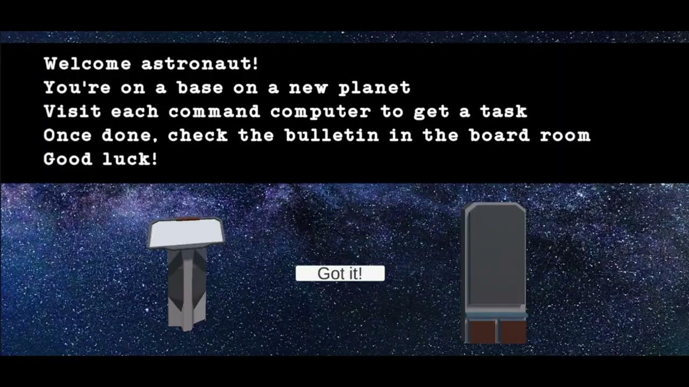
Video

Slide 18
Thanks!
Please keep this slide for attribution

